Slide 1
BINOMIAL EXPANSION
(BINOMIAL EXPANSION)
DR ILOJIDE E.

Slide 2
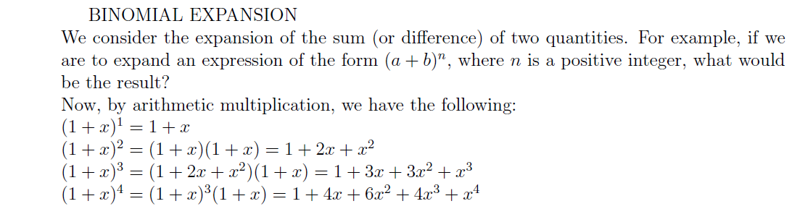
BINOMIAL EXPANSION

Slide 3
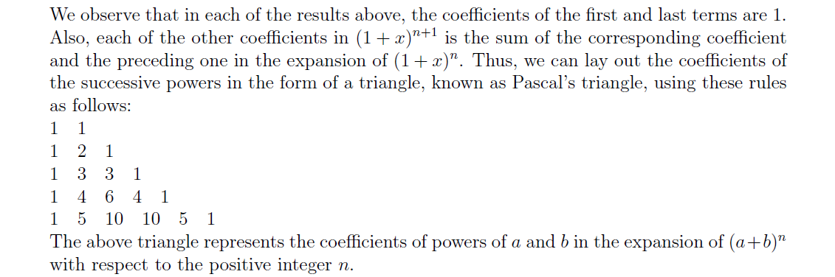
BINOMIAL EXPANSION

Slide 4
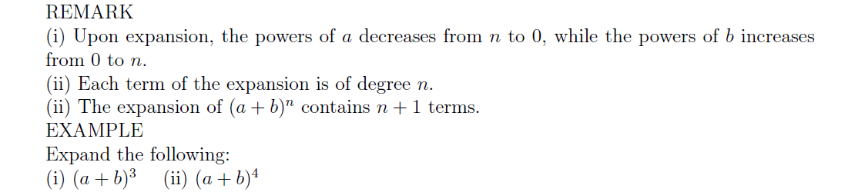
REMARK

Slide 5
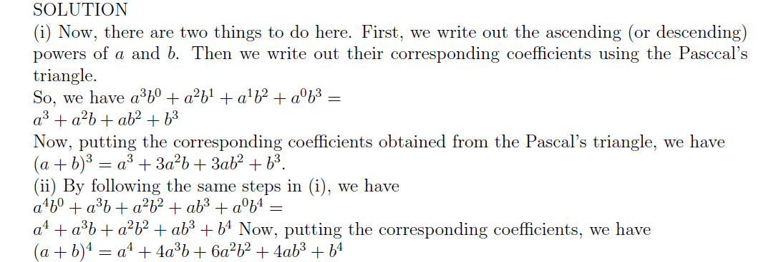
SOLUTION

Slide 6
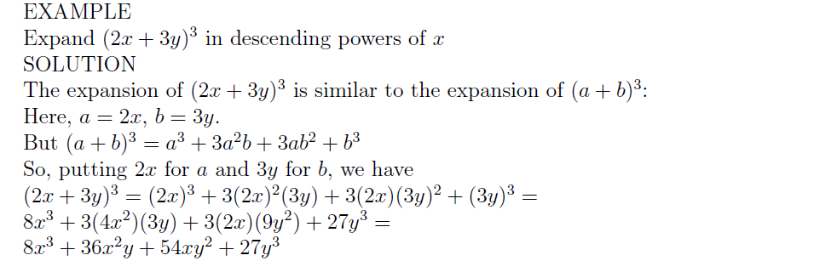
EXAMPLE

Slide 7
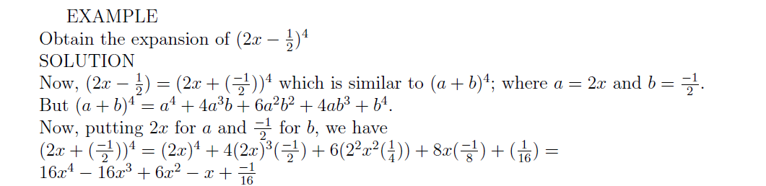
EXAMPLE

Slide 8
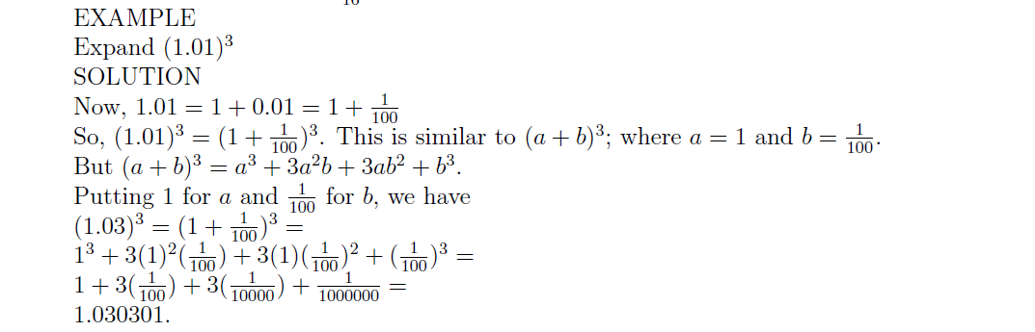
EXAMPLE

Slide 9
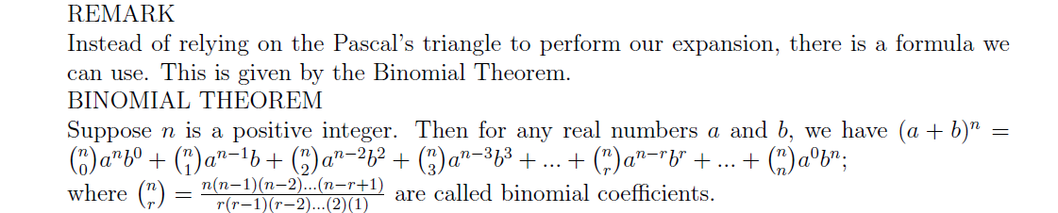
BINOMIAL THEOREM

Slide 10
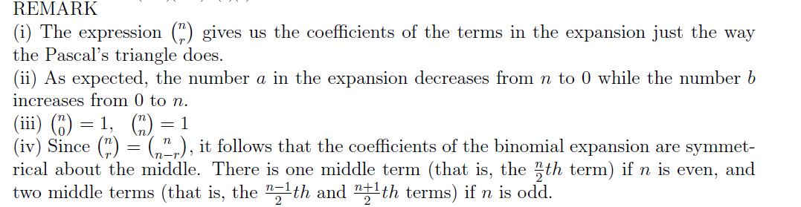
REMARK

Slide 11
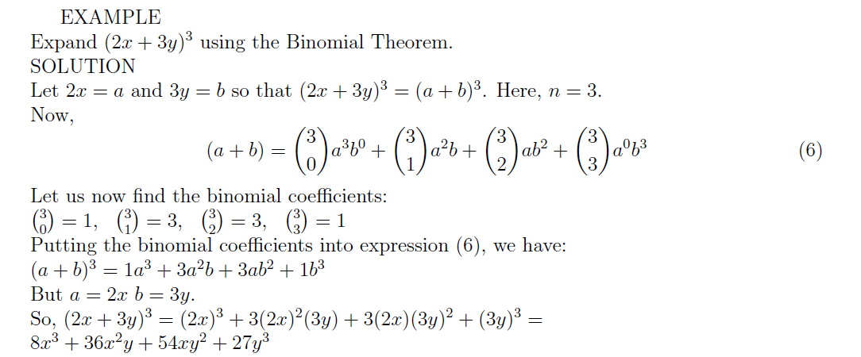
EXAMPLE

Slide 12
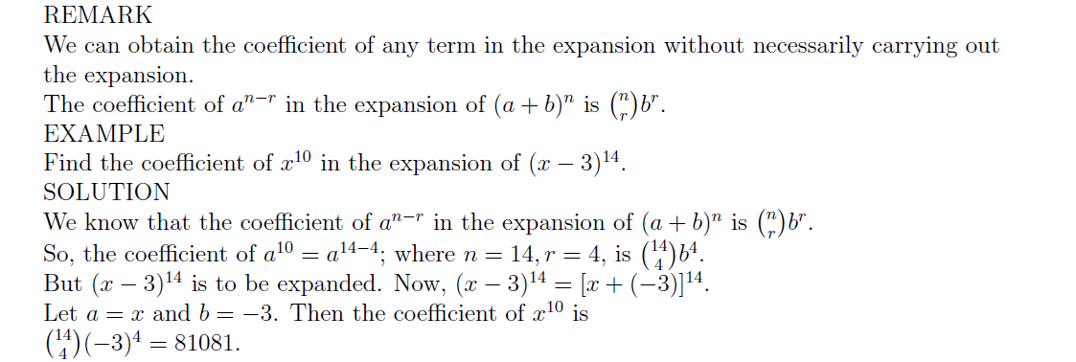
REMARK

